Slide 1
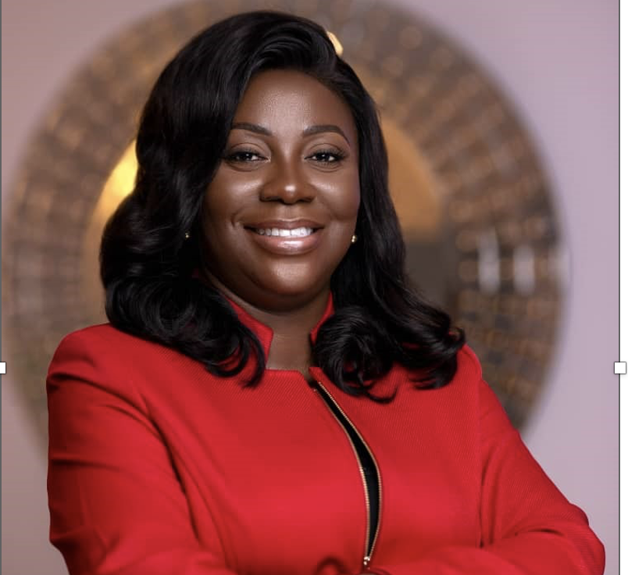
Elon Musk: SpaceX
Patricia Obo-Nai –
Digital Transformation &
Network in Ghana
Akinwumi Adesina – High 5s
Initiative (Light Up & Power Africa,
Feed Africa, Industrialize Africa,
Integrate Africa, Improve the
Quality of Life for the people of
Africa)

Slide 2
Navigating Uncertainty:
Sustainable Project Management in a Changing World
Jumoke Lafenwa MRes., MBA, Eng., MBA, PMP®, PMI-PBA® , PMI- PBA®, PMI AH-MC® SMC™, SAMC™
Immediate Past President, PMI Ghana
Managing Partner, Okin Value
25 July 2024

Slide 3
Context
Navigating Uncertainty: Solutions for a Changing World
https://youtu.be/XZfmT8_jkCM?si=A9sOVBjME9tkBgiM

Slide 4
Global Landscape: increasing uncertainty + complexity
Technological Advancements and Digital Transformation
Economic Volatility
Environmental and Sustainability Concerns
Social and Political Instability
Health Crises and Pandemic
Stakeholder Expectations and Engagement
Agile and Hybrid Methodologies

Slide 5
Key Strategies for Navigating Uncertainty
Embracing Agility
Risk Management
Stakeholder Engagement
Identification of Risks
Analyze & Prioritize of Risks
Respond & Monitor Risks
Effective Stakeholder Engagement
Agile Methodologies
Iterative Planning
Continuous Improvement
Sustainable Value Delivery
Effective Risk Management
+
Resilient Team
=
and/or
Continuous Improvement

Slide 6
Effective Risk Management Strategies
.
1
Proactive Risk Identification
2
Contingency Planning
Regularly scanning the horizon to anticipate potential
risks and plan mitigation strategies.
Developing alternative scenarios and backup plans
to ensure project resilience.
3
Continuous Risk Monitoring
4
Collaborative Approach
Implementing robust risk management processes to
quickly identify and address emerging issues.
Engaging the entire project team in risk assessment and mitigation activities.

Slide 7
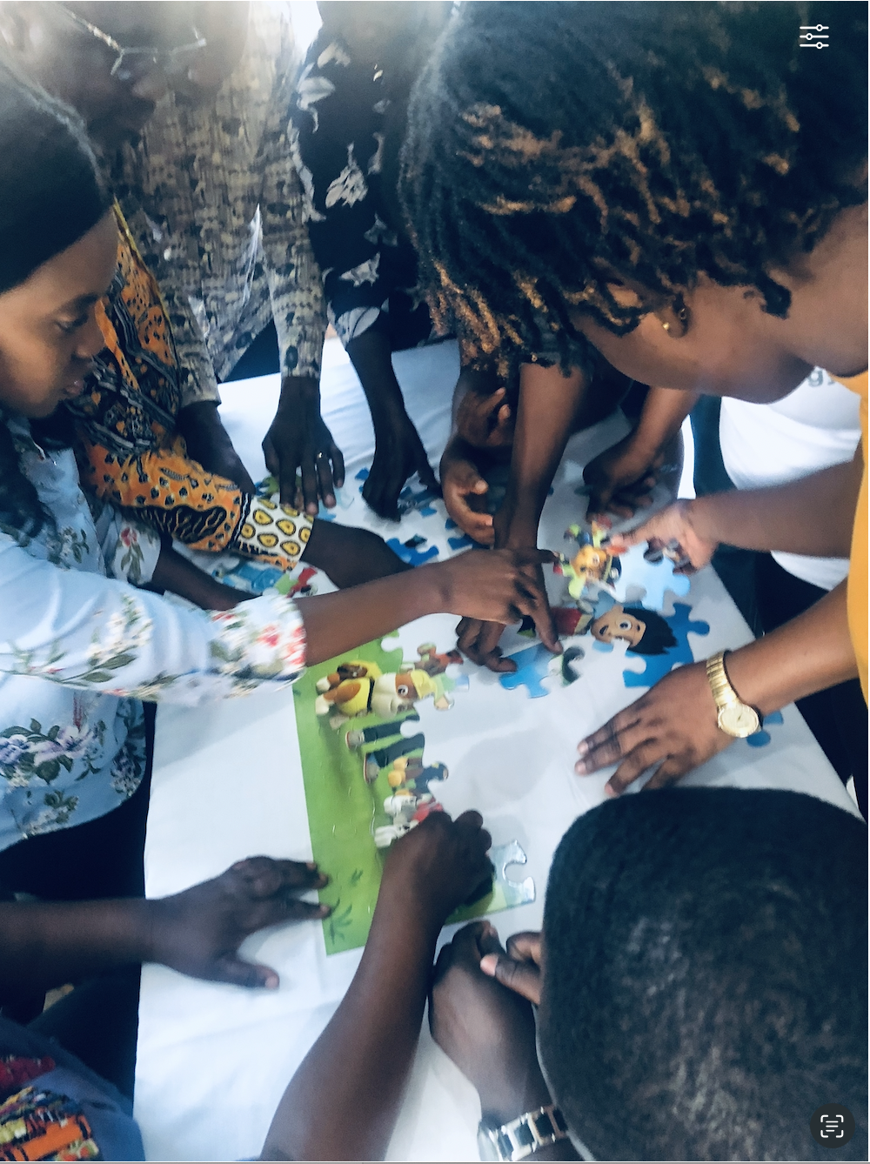
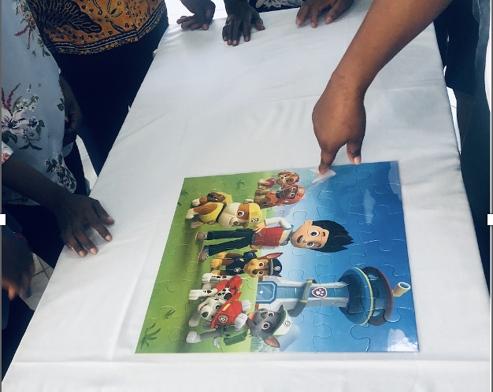
Fostering Resilient Teams
Psychological Safety
Empowerment and Autonomy
Creating an environment where team members feel comfortable taking risks and voicing concerns.
Enabling team members to make decisions and take ownership of their work.
Continuous Learning
Emotional Intelligence
Encouraging team members to share knowledge, seek feedback, and develop new skills.
Cultivating interpersonal skills to navigate the human aspects of project management.

Slide 8
Skills of the Project Manager
Adaptability
Change Management
Critical Thinking
Decision Making
Emotional Intelligence
Human Capital Management
(ACCDEH)

Slide 9
Case Studies and Examples
1 out of 3
Netflix Transition to Streaming
Challenge:
Transitioning from a DVD rental
Service to a streaming services
- Technological challenges;
- Competition from established media houses
Success:
Netflix’s Project Management team successfully
Navigated by:
- Embracing New Technology
- Scaling their infrastructure
- Continuous adaptation of business model

Slide 10
Case Studies and Examples
2 out of 3
Ghana’ Cocoa Sustainability Team
Challenge:
- Ensuring sustainable cocoa production amidst
Climate change, deforestation, and fluctuating
market prices;
Success:
- Implemented programs with focus on
Sustainable farming practices
Reforestation
Fair Trade certification

Slide 11
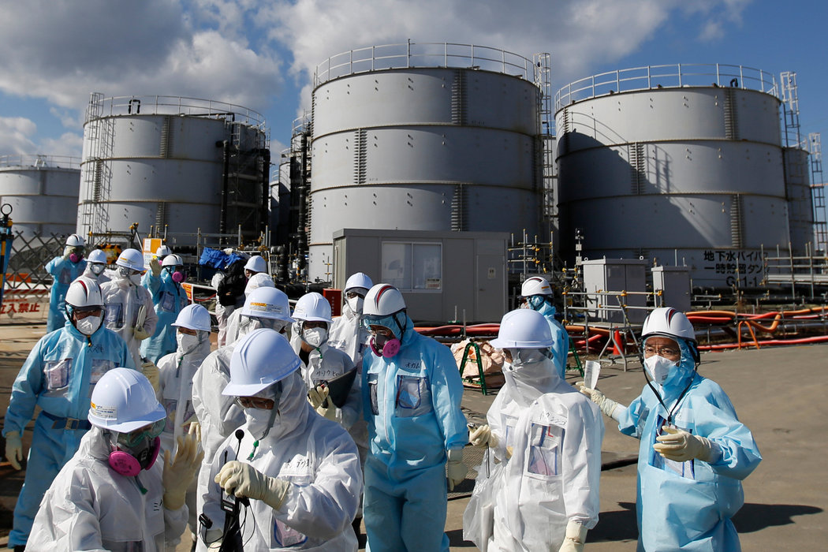
Case Studies and Examples
3 out of 3
Fukushima Daiichi Nuclear Disaster
Response Team
Challenge:
Nuclear plant severely damaged by an
Earthquake and tsunami in 2011, resulting in a
Nuclear meltdown
Success:
The response team worked tirelessly under
Hazardous conditions to stabilize the reactors,
Mitigating radiation leaks.
Their resilience and dedication helped prevent
a more catastrophic disaster.

Slide 12
Practical Takeaways
Navigating uncertainty in projects requires a proactive, adaptable, and strategic approach.
Risk Management
- Identify Risks Early | Develop Contingency Plan | Monitor Continuously
2. Agile and Adaptive Planning
- Adopt Agile Methodologies | Prioritize Flexibility
3. Stakeholder Engagement
- Communicate Regularly | Build Relationships | Manage Expectations
4. Continuous Improvement
- Regular Reviews | Document Lessons Learned
5. Utilize Technology
- Leverage Project Management Software | Implement Data Analytics | Embrace Automation

Slide 13
Vision for the Future
Some visionary aspects that are likely to shape the future of project management:
Integration of Advanced Technologies
Agile and Adaptive Methodologies
Focus on Human-Centric Project Management
Global Collaboration and Remote Work
Enhanced Risk Management and Resilience
Data-Driven Decision Making
Improved Stakeholder Engagement and Communication
Lifelong Learning and Skills Development
Be INTENTIONAL!!!

Slide 14
Let’s Connect
LinkedIn: Jumoke Lafenwa
Instagram: Jumoke Lafenwa
Facebook: Jumoke Lafenwa
YouTube: Jumoke Lafenwa
X: Jumieb2
Email: jlafenwa@gmail.com
WhatsApp: 0244 544 964

Slide 15
Thank you

